Slide 1
Be As Professional
As YOU Can Be…
All the Time!
Marcie Roggow, ABR/M, CCIM, CRB, CRS, DREI, GRI, SRS
marcie@marcieroggow.com
www.marcieroggow.com

Slide 2
What is the responsibility of the agent
Code of Ethics Preamble:
Under all is the land! It’s the basic of everything in real estate, food, shelter, economy and prosperity.
Ownership of the land: Our nation was founded on the premise that everyone had the right to own the land – direct opposite from England where the King held the land.
Integrity of the Real estate Profession…competency and fairness

Slide 3
Are we teaching the right stuff?
“The subject of etiquette has often been treated like the subject of sex used to be: no one talks about it! Few people will tell us when we make a blunder. Then if they do, we almost die of embarrassment.”
June Hine More
The Etiquette Advantage

Slide 4
Mass Law vs. Ethics
Law: Legal Standards generally set minimum standards of conduct.
Ethical Standards: encompass principles higher than the legal standards
Article 10 of the NAR Code of Ethics is a prime example
Industry Codes: Company policies, Individual Moral Codes and License Laws
Self Discipline for ethical violations: lawyers, doctors and of course REALTORS® Internally measuring the behavior

Slide 5
Moral Character: (254 CMR 2.0)
Each individual seeking a real estate license shall furnish evidence of good moral character
Applications for license shall include recommendations f REPUTABLE citizens, not related to the applicant, who reside in or have their place of business in Massachusetts
Each recommendation shall certify that the individual bears a good reputation for HONESTY and fair dealing and shall recommend that a license be grated to such individual

Slide 6

Why is the Real Estate Industry Studying
Business Etiquette?

Slide 8
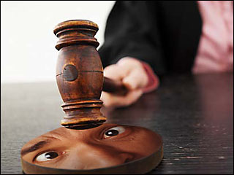
10 TOP Violations At Commissions
Misrepresentation
Unethical conduct
Agency
Disclosure issues
No Reasonable skill
No Communication
Mishandling of funds
Breach of duties
Unprofessional Conduct
Advertising violations

Slide 9
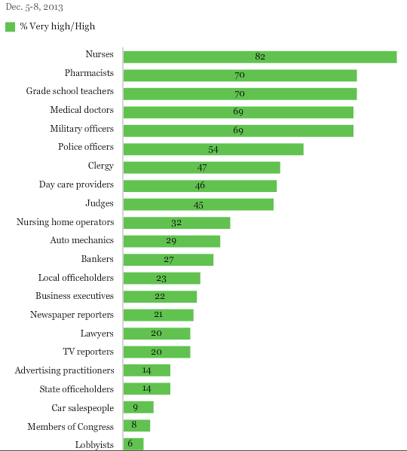

Slide 10


Slide 11

https://www.youtube.com/watch?feature=player_embedded&v=YUnO1MuGzdo
https://www.youtube.com/watch?feature=player_embedded&v=XEhDA66ub8o

Slide 12
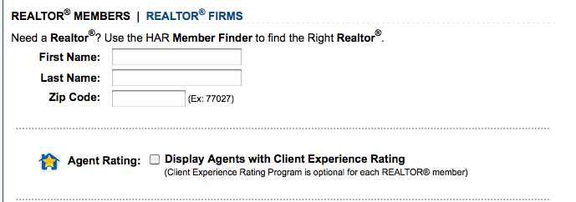

Slide 13
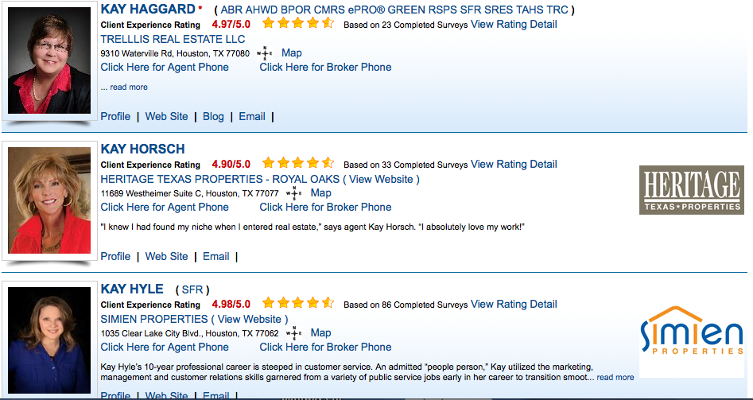

Slide 14



Slide 15
What did the Survey show?
-1/3 of homebuyer/sellers are contacted by their agent post closing
-1/2 homebuyers/sellers are satisfied with the communication provided by agent
40% are less than satisfied with sales agent attention to details
-50% of customers are very likely to use the same agent again
-40% are very likely to use the same company again

Slide 16
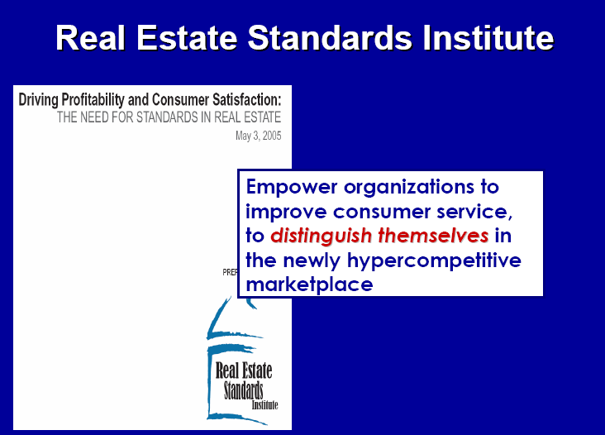

Slide 17
Specific Ethical Issues for Licensees
Promote and Protect your client’s best interests and treat all parties honestly: Customers/clients/consumers Article I of the NAR COE
Avoid exaggeration, misrepresentation and concealment of pertinent facts about the property or the transaction. Discover material facts only within your scope of licensure
Article 2 of the NAR COE (know or should have known)
Co-operate with others in the transaction. MLS Systems, Co-operate vs Compensate Article 3 of NAR COE

Slide 18
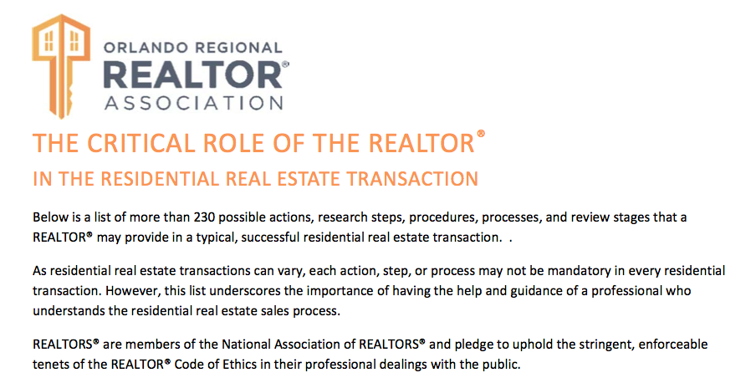

Slide 19


Slide 20
WHAT CUSTOMERS WANT
One-of-a-kind Experiences
Personalized
Genuine Service
Fast Access to
Knowledge and
Wisdom
Value
Utility and Total
Lack of Hassles
Convenience and
Respect of Time

Slide 21
The Ritz-Carlton Credo
(What We Do)
Defines what we are in business to create
Defines what every guest should experience
The blueprint for all guest interactions
It is our moral compass and organizational context ….
“When in doubt, refer to the Credo”

Slide 22


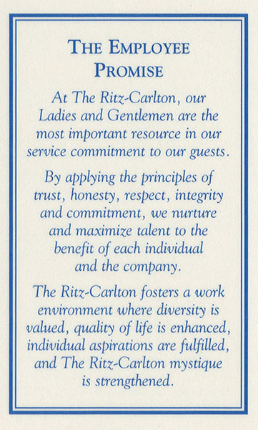
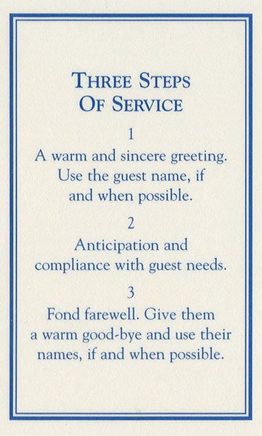
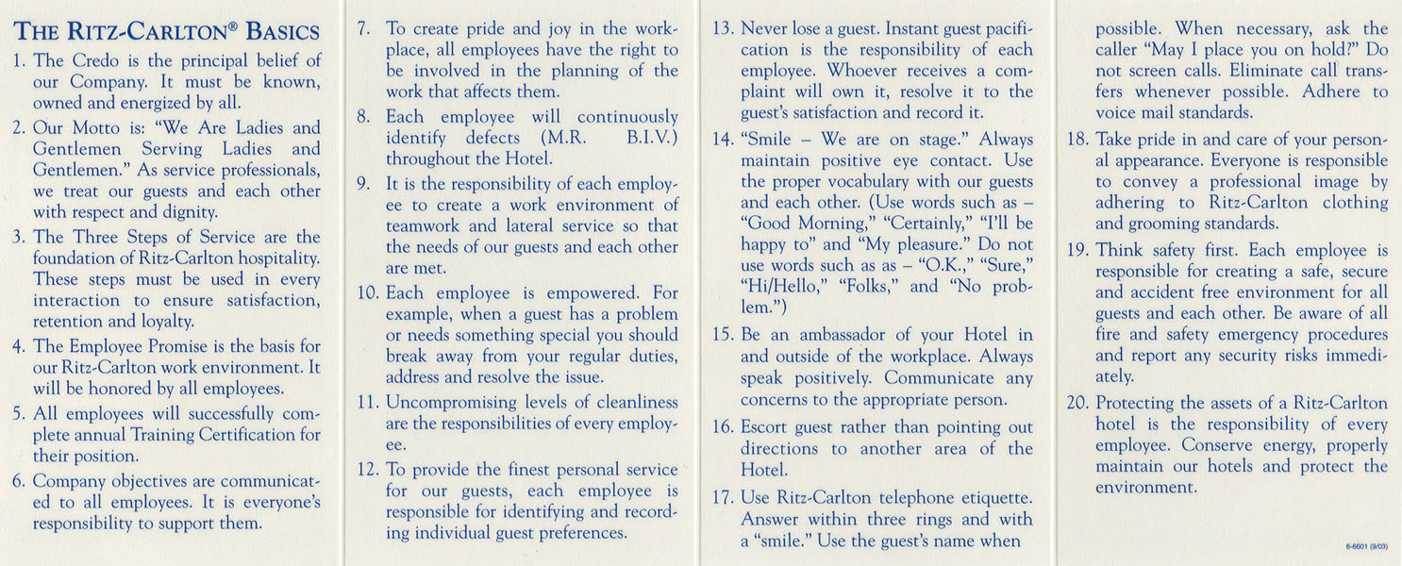
THE GOLD STANDARDS
Notes:
Facilitator: first tel story 1, then click mouse for Credo and tell story 2, etc. After story 4, go over the basics, superficial with the Credo Card
1. The President of our Company, Mr. Schulze actually created the Motto and the years before the establishment of The Ritz-Carlton. He used the Motto and 3 Steps of Service as his personal philosophy. Once The Ritz-Carlton was established, they were formalized and used as training tools and guidance tools for all Ritz-Carlton employees.
When the company was established in 1983, the Steering Committee created a Mission Statement. They used this statement during the ten day count-downs (opening schedule) at Boston, Atlanta Buckhead, Naples and Laguna Niguel to train and energize employees on The Ritz-Carlton philosophy. After the fifth hotel (Naples) opened, the Steering Committee reviewed the successes and challenges of the previous openings and looked at ways to improve the process. During a three day retreat, the Steering Committee determined that the Mission Statement was too broad and overwhelming to teach employees. It needed to be condensed into a basic philosophy which would be easy for employees to embrace. Through brainstorming, the Committee reduced the Mission Statement into our Credo. Employees of every culture, background and work experience level could embrace this Credo. Over time, it progressively grew into the Gold Standards we have today. Discuss.
 2. The Credo is - the statement about the environment and experience that we want to create for our guest and fellow employees. The Credo simply states that customer satisfaction is our top priority and everyone’s job. We focus our attention on the satisfaction of both internal and external customers. The Credo describes the characteristics of Ritz-Carlton products and services. Discuss.
 3. When Mr.. Schulze was 14 years old, he left home and his small village that he had grown up in to learn about the hotel industry. At that point in his life, Mr.. Schulze had never been in a restaurant before. When he began working as a busboy, he said that at first he was in awe of the guests. Then, as he began to observe the activity of the restaurant each day, he became in awe of the Maitre d’. He realized that the Maitre d’ was just as important as the guest. He seemed to know everything that the guest wanted and was able to fulfill their wishes.
It was then that Mr.. Schulze realized how important the employee is. It doesn’t matter what job we are fulfilling, we can still have a direct impact on the guest through our attitude and interactions with our co-workers.
The concept of “ Ladies and Gentlemen serving Ladies and Gentlemen” tells us who we are and how we should behave. The motto emphasized mutual respect for one another and the respect we should have for ourselves. It creates a positive work environment and is an attitude that can be accepted or appreciated by anyone from any culture or walk of life.
 4. The key element in the 3 Steps of Service is that we start using them the instant we make contact with a guest or other employee. We must begin each interaction with a “warm welcome.” This applies to any circumstance … the way we answer the phone, how we serve a table how we greet one another in the hallways.
Compliance is about caring. It’s our warm, relaxed and refined style in assisting and ensuring that we are actually getting the guest what he/she wants and needs rather than what we think he/she wants and needs.
The Fond Farewell gives us an opportunity to thank the guests fore using our services and staying with us. As well, it gives us an opportunity to invite them back. The 3 Steps of Service should be used during every interaction you have with a guest or co-worker.  Then of course, the employee promise

Slide 23
THE RITZ-CARLTON CREDO
The Ritz-Carlton Hotel is a place where the genuine care and comfort of our guests is our highest mission.
We pledge to provide the finest personal service and facilities for our guests who will always enjoy a warm, relaxed yet refined ambience.
The Ritz-Carlton experience enlivens the senses, instills well-being, and fulfills even the unexpressed wishes and needs of our guests.

Slide 24
OUR MOTTO
(The Way We Do It)
“We are Ladies and Gentlemen serving Ladies and Gentlemen”
The Motto governs our actions, attitudes, behavior and,
therefore, our relationships.
Defines the guest to staff member relationship.
Defines the staff to staff relationship.
Defines the relationship that leadership and staff have.
It tells you that you are not servants or subservient. Rather, you are a service professional!

Slide 25
Engaged customers “can’t imagine a world without The Ritz-Carlton”.

Slide 26


Slide 27

It’s imperative that you know who the buyers and sellers are in your market place and know what they expect you to do for them. The NAR survey provides you with that information !

Slide 28

Today’s Consumer!
…is ready, willing and able to acknowledge, relish and compensate the “WOW” in their next real estate transaction!
Are YOU ready to deliver it?

Slide 29
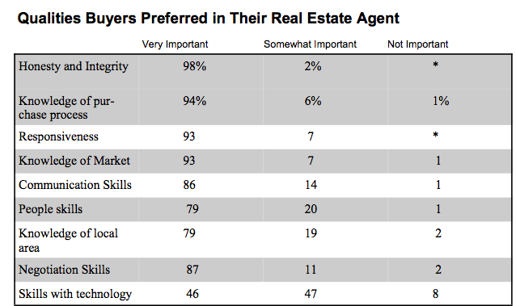

Slide 30







































All of the media ….systems
Will not beat exceeding the expectations of the client.
Notes:
So how did ethics get involved. Why would professional standards need to start looking at these forms of social media. Because any time you connect with clients or even friends through any medium and you are a licensed real estate professional you must disclose that fact if the topic of real estate is being discussed! And…when is that NOT happening today. REALTOR associations are using Web 2.0 more frequently to update members and to make sure that changes are reaching them as they happen. Lenders are sending out notices of interest rate reductions and the buyers are holding onto their PDAs waiting for the call-text-email, whatever. Just walk down the street in any city and see if you can even pass more than 10 people that aren’t connected to something in some way. So whichever one of these flavors you or your associates or members are ‘tasting’….it will undboutedly affect their postiion as a real estate licensee at some point.

Slide 31
Core Components
Competency Accuracy
Communication

Slide 32
Five Ways To Assess Service
Empathy
Reliability
Assurance
Responsiveness
Tangibles

Slide 33

Picture Before

Slide 34

Picture After….

Slide 35

Timely Communication

Slide 36

How does your client want to communicate with you?

Slide 37


Necessities in Communication
Conversation
Listening
Correspondence

Slide 38
Take a Tip from Marriott
89% of guests with no problems ….we’ll be back
69% of guests with problems not resolved…we’ll be back
94% of guests with problems that were resolved…we’ll be back

Slide 39
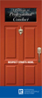
Pathways To Professionalism
Order on line at
REALTOR.org and give to all of your buyers and sellers.

Slide 41
“True ethics means
holding yourself to the highest
level of behavior
because you want to—
not because you’re
afraid of getting caught and
punished for flouting
a specific rule.”
~Peggy and Peter Post
The Etiquette Advantage in Business

Slide 42
Article 1
When representing a buyer, seller, landlord, tenant, or other client as an agent, Realtors® pledge themselves to protect and promote the interests of their client. This obligation to the client is primary, but it does not relieve Realtors® of their obligation to treat all parties honestly. When serving a buyer, seller, landlord, tenant or other party in a non-agency capacity, Realtors® remain obligated to treat all parties honestly. (Amended 1/01)

Slide 43
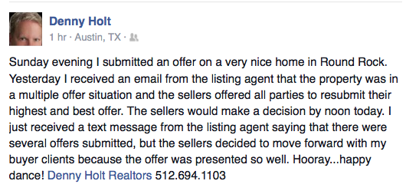

Slide 44
Article 9
Realtors®, for the protection of all parties, shall assure whenever possible that all agreements related to real estate transactions including, but not limited to, listing and representation agreements, purchase contracts, and leases are in writing in clear and understandable language expressing the specific terms, conditions, obligations and commitments of the parties. A copy of each agreement shall be furnished to each party to such agreements upon their signing or initialing. (Amended 1/04)

Slide 45
Article 16
Realtors® shall not engage in any practice or take any action inconsistent with exclusive representation or exclusive brokerage relationship agreements that other Realtors® have with clients. (Amended 1/04)

Slide 46
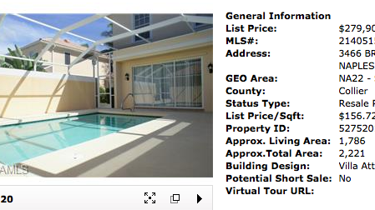


Slide 47
“Diplomacy is an excellent approach to helping any situation that involves behavioral issues. Avoid using blaming words… focus on being helpful instead of harmful. It is not necessarily what you say, but what words you choose to say it with when dealing with a difficult situation.”
~Gloria Peterson

Slide 48


Handling Criticism

Slide 49
Article 12
Realtors® shall be honest and truthful in their real estate communications and shall present a true picture in their advertising, marketing, and other representations. Realtors® shall ensure that their status as real estate professionals is readily apparent in their advertising, marketing, and other representations, and that the recipients of all real estate communications are, or have been, notified that those communications are from a real estate professional. (Amended 1/08)

Slide 50
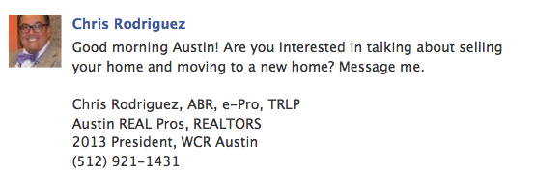
Inducing for business:

Slide 51
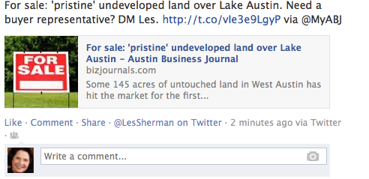


Slide 52
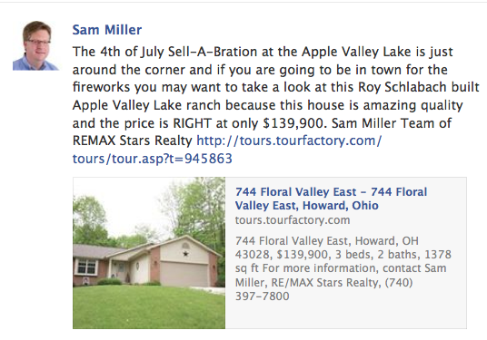

Slide 53
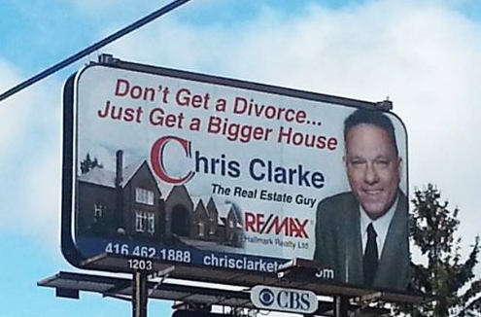

Slide 54




The fore fathers never dreamed…
SOP:12-8
“Obligation to present a true picture!”
Notes:
I remember a year ago we were sitting in professional standards when we discussed the amazing skill several of our realtor members had obtained through photo shop. Yes..we can change the grass to green. Remove power lines, even take out a dead bush or two…no one will be the wiser…unti they try to go find the house.
Recently there was a case where I was called in for advice. The problem was that the virtual tour of the home showed the draperiers all nicely hung. (mind you there was furniture too) but when the buyers LOOKED at the house the furniture and the draperies were gone. Yet before they closed they insisted that the drperies were returned….even though they were not included in the purchase contract. So presenting a true picture can take on many forms. The discussion about what could be changed in a picture and what couldn’t be I must admit did get me chuckling….(snow story)

Slide 55
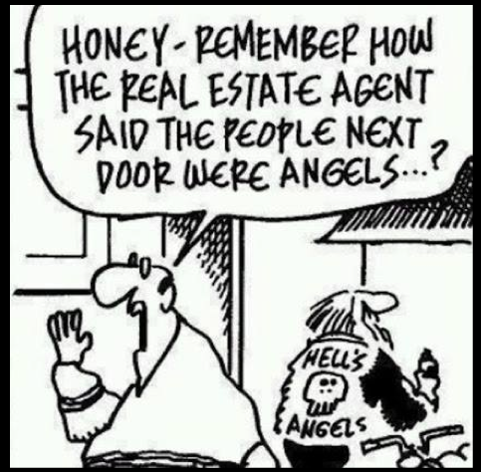

Slide 56
SOP 12-13
The obligation to present a true picture in advertising, marketing, and representations allows REALTORS® to use and display only professional designations, certifications, and other credentials to which they are legitimately entitled. (Adopted 1/08)
Marcie Roggow
ABR/M, CCIM, CRB, CRS, DREI, SRS
Notes:
The CCIM (Council of Commercial Investment Members) last May brought to Pro Standards a cause of action. Like all of the NAR designations they were experiencing members using the designation but NOT having paid their dues. At CRS we used to talk about sending someone in to ‘rip the plaque off the wall of the non paying member. But the CCIMs were able to bring forth this SOP and now for all of you who monitor the use of designations is the answer to your prqyers…its one way to meet the members of the professional staandards committee quickly.

Slide 57
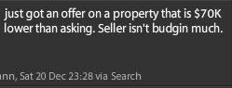
Confidentiality you say?
Xxxxxxx(agent’s name) 5 showings today on my brand new listing. It was priced right. At least one offer is coming in and it's full price, no concessions. I posted it earlier today on FB, Twitter, MySpace, and all the usual suspects.
Now, keeping in mind that tweets could be entered as evidence in court, consider this tweet (I've removed the name from this one):
Notes:
Whoa. As a broker-owner, I'd have grave concerns about one of my agents tweeting this. Chances are, and we hope, this single tweet will not affect the outcome of the home sale for this Twit's client but boy you can imagine numerous scenarios where it could and would affect the outcome. Imagine I'm a buyer considering writing an offer just $30K below asking. Well heck, I don't want to overpay for the property. If someone else was offering so much less, maybe it's not worth what I thought it was. Maybe I should write an offer for $80K under asking.
Is this kind of disclosure a breach of fiduciary duties to the seller clients? As professional real estate agents, shouldn't we be maintaining confidentiality about ongoing negotiations? Like other electronic communication such as email, once you hit 'enter' your tweets are out in the public domain, indelible (yes tweets create a permanent record on the internet which you CANNOT delete), and discoverable by a court of law. The National Law Journal has a great article entitled, "Beware: Your 'tweet' on Twitter could be trouble".
Perhaps tweets will not cause you to be involved in a lawsuit. They may still cost you clients. Check out this tweet (again I removed the name but in fact anybody can find these posts by searching twitter):

Slide 58
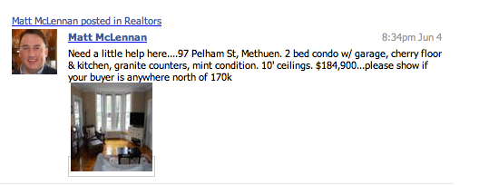

Slide 59
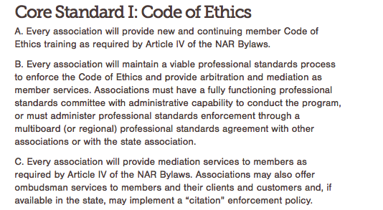

Slide 60
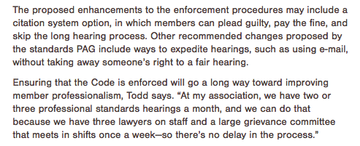
NAR Mandate: Citations

Slide 61
1. As an option for the Grievance Tribunal, an ethics complaint may be eligible for the citation program if there is an alleged violation, identified under the Model Citation Schedule of Articles 3, 4, 5, 6, 12, 14 and/or 16, provided the complaint does not also include articles which are not included in the citation program (i.e. Articles 1, 2, 7, 8, 9, 10, 11, 13, 15 or 17).

Slide 62
OMBUDSMAN SERVICE
The Ombudsman Service is TAR’s informal telephone mediation service which is offered to attempt to resolve a dispute against a REALTOR® member. The dispute must be an association matter such as assisting parties regarding potential ethics violation or arbitrable matters. TAR Staff will attempt to verify that the dispute is a possible ethics or arbitrable matter before assigning to an ombudsman. Ombudsman should NOT give legal advice or any unauthorized practice of law. NAR’s E & O insurance will not provide coverage to Ombudsman in these instances. The Ombudsman is a service we provide (good PR) so that the complainant can vent and, whenever possible, get the issue resolved. The exceptions to this would be if there is possible discrimination or public trust. Ombudsman is an alternative to filing a formal complaint. The complainant is told that the Ombudsman will contact them within 48 hours and if the ombudsman does not call within that time frame, to call TAR back and we will reassign to a new Ombudsman.

Slide 63

How Does the public see you?

Slide 64
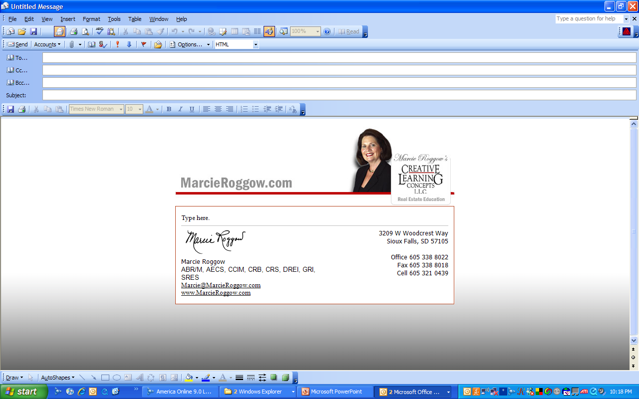

Slide 65
…AND ANSWER QUESTIONS ON TRULIA VOICES
“As for the MLS or discount brokers, sometime it does appear on the MLS but 1) that broker only wants to list your house to get buyer leads so he can sell them other homes that aren’t overpriced. 2) Me being a realtor, I know which brokers are discount brokers and I never show there homes. If I bring an offer and then the owner gets a little lower offer he will take that one because he is FSBO and doesn’t have to pay commission so I wasted my time showing that home and not get paid. 3) If I show it and the buyers go directly to the owner then im out of commission so I steer them away from those properties. Do it right the first time and hire a qualified realtor rather then waste your money GOOD LUCK!!!!”

Slide 66
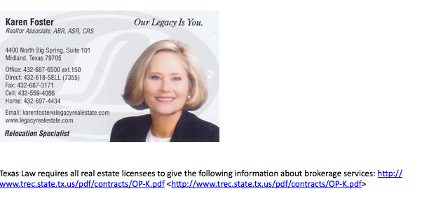
Picture/signs/

Slide 67
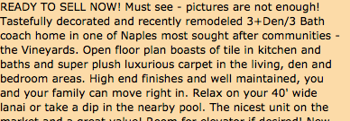
Great ad….right?

Slide 68



You be the judge….

Slide 69

“Packaging Yourself:
Dressing for Business”
By June Hines Moore

Slide 70
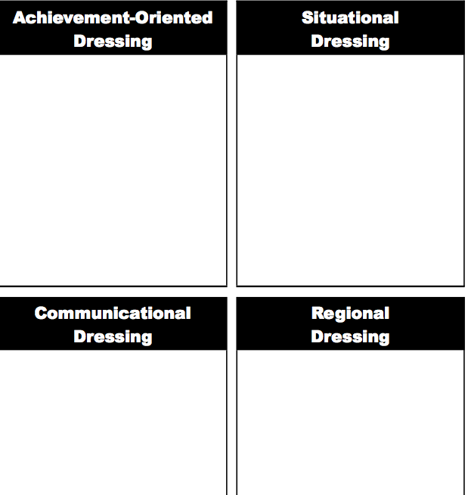

Slide 71

Behavior Never Lies
Trust that has been cracked can be repaired, but not rebuilt to its original condition. The contradiction between what is said and what is done will destroy one’s respect for another. Trust is only solid when the spoken word and behavior are in sync.

Slide 72
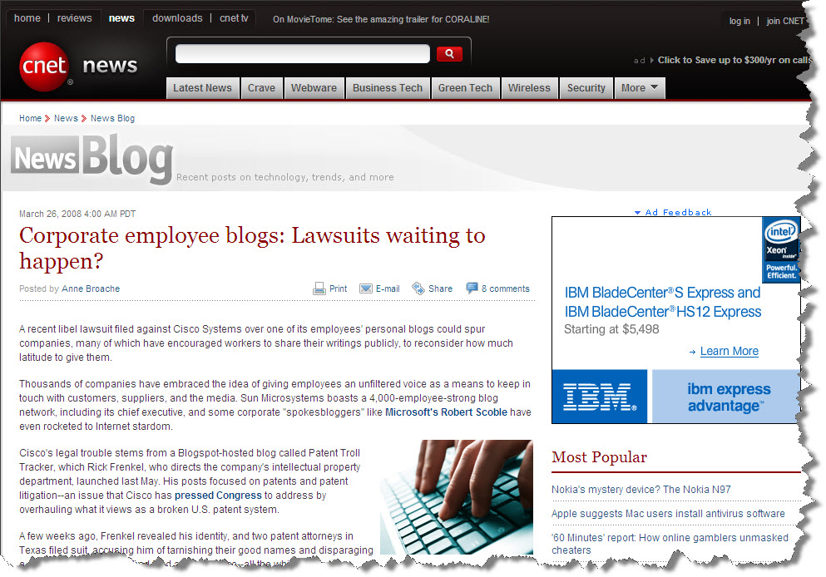
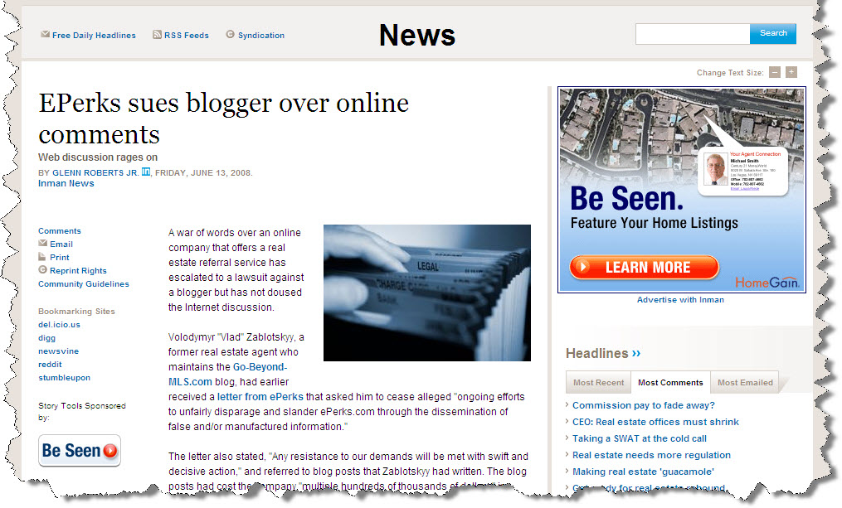
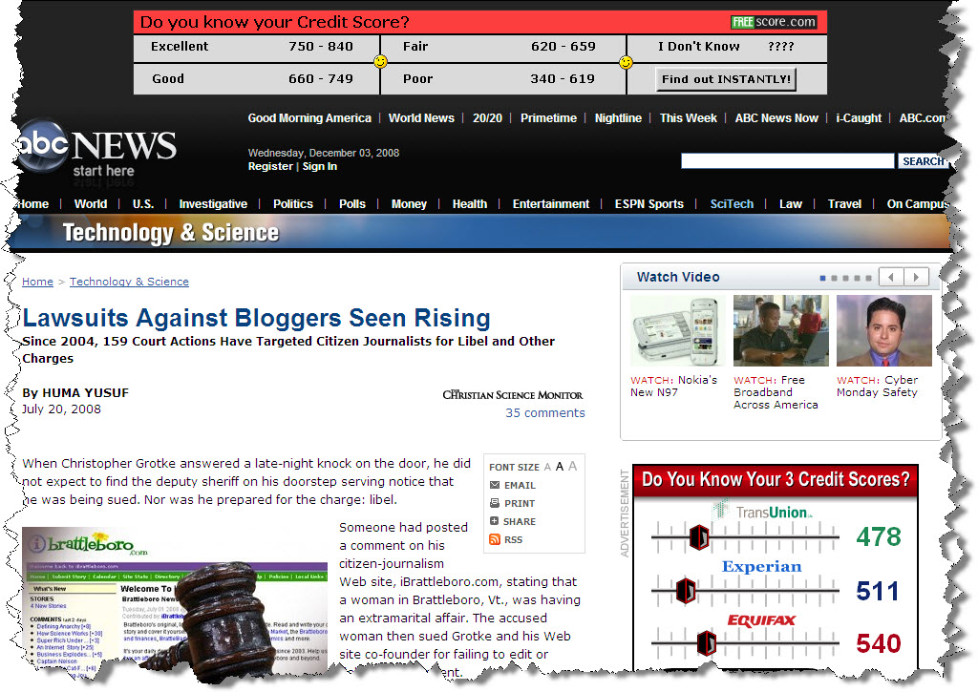
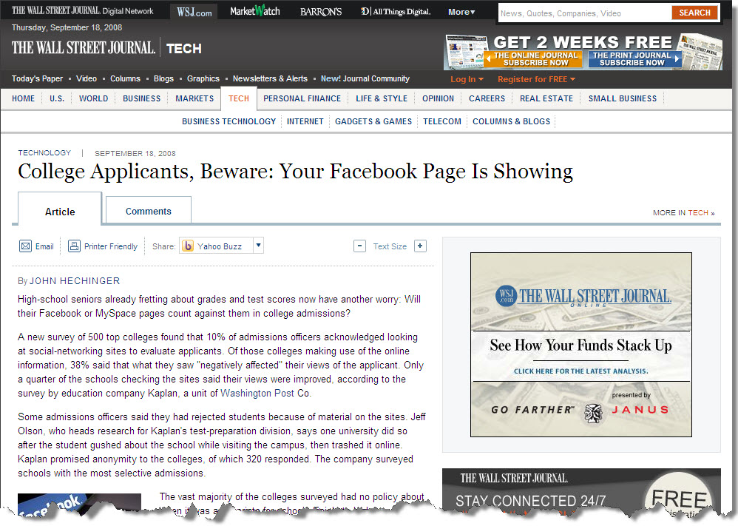
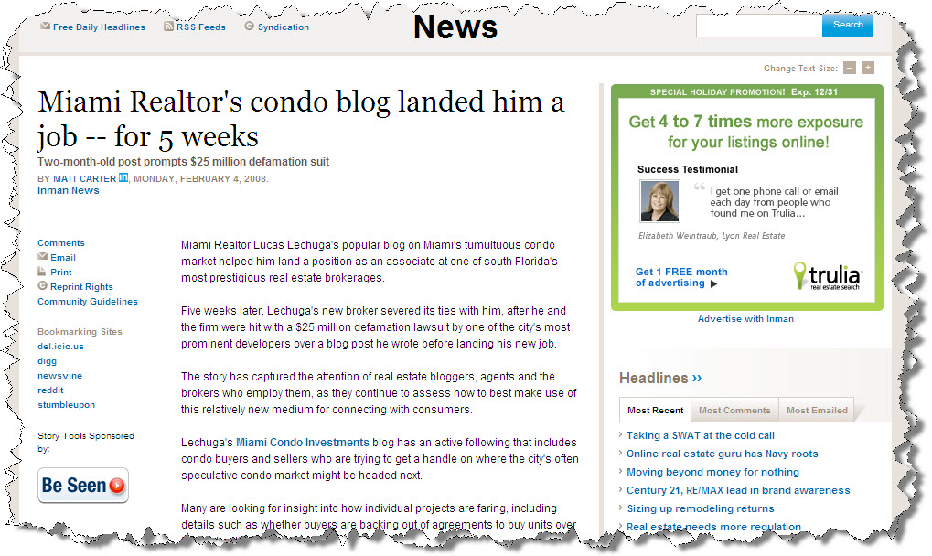
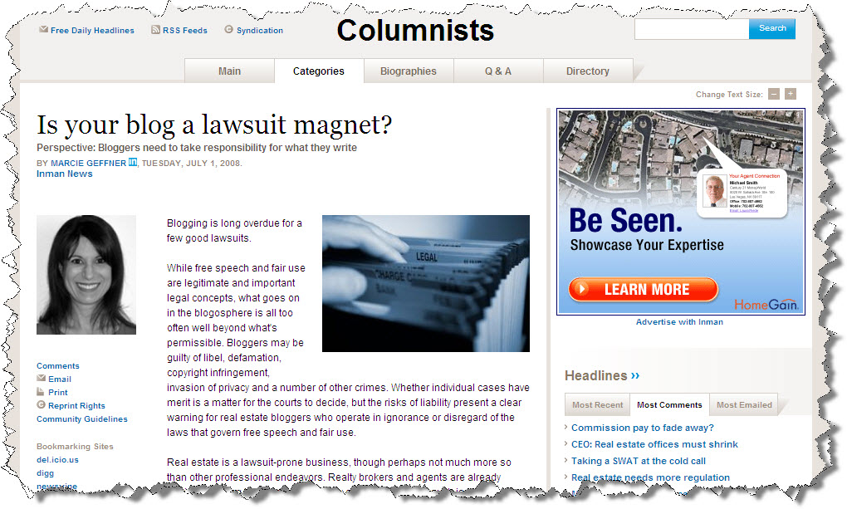
What Are the Odds?
Notes:
Blogging became a fast hit with realtors. It was a way to promote a city, a neighborhood, yourself…how and when to buy…when to sell…market conditions, etc! Well the probably with blogging is that it is normally ‘your opinion’…so when that opinion turns out to be wrong, then what you have is the potential for a lawsuit and shown by thiese articles.

Slide 73
Engaged customers “can’t imagine a world without The Ritz-Carlton”.
How about YOUR customers/clients?

